Slide 1

AWS Shield
presented by:
R.sathya soroopan B.tech

Slide 2

AWS Shield: Protecting Your Applications from DDoS Attacks
AWS Shield is a managed Distributed Denial of Service (DDoS) protection service that safeguards applications running on AWS. It ensures the availability and reliability of your cloud resources, offering robust protection across network, transport, and application layers.

Slide 3

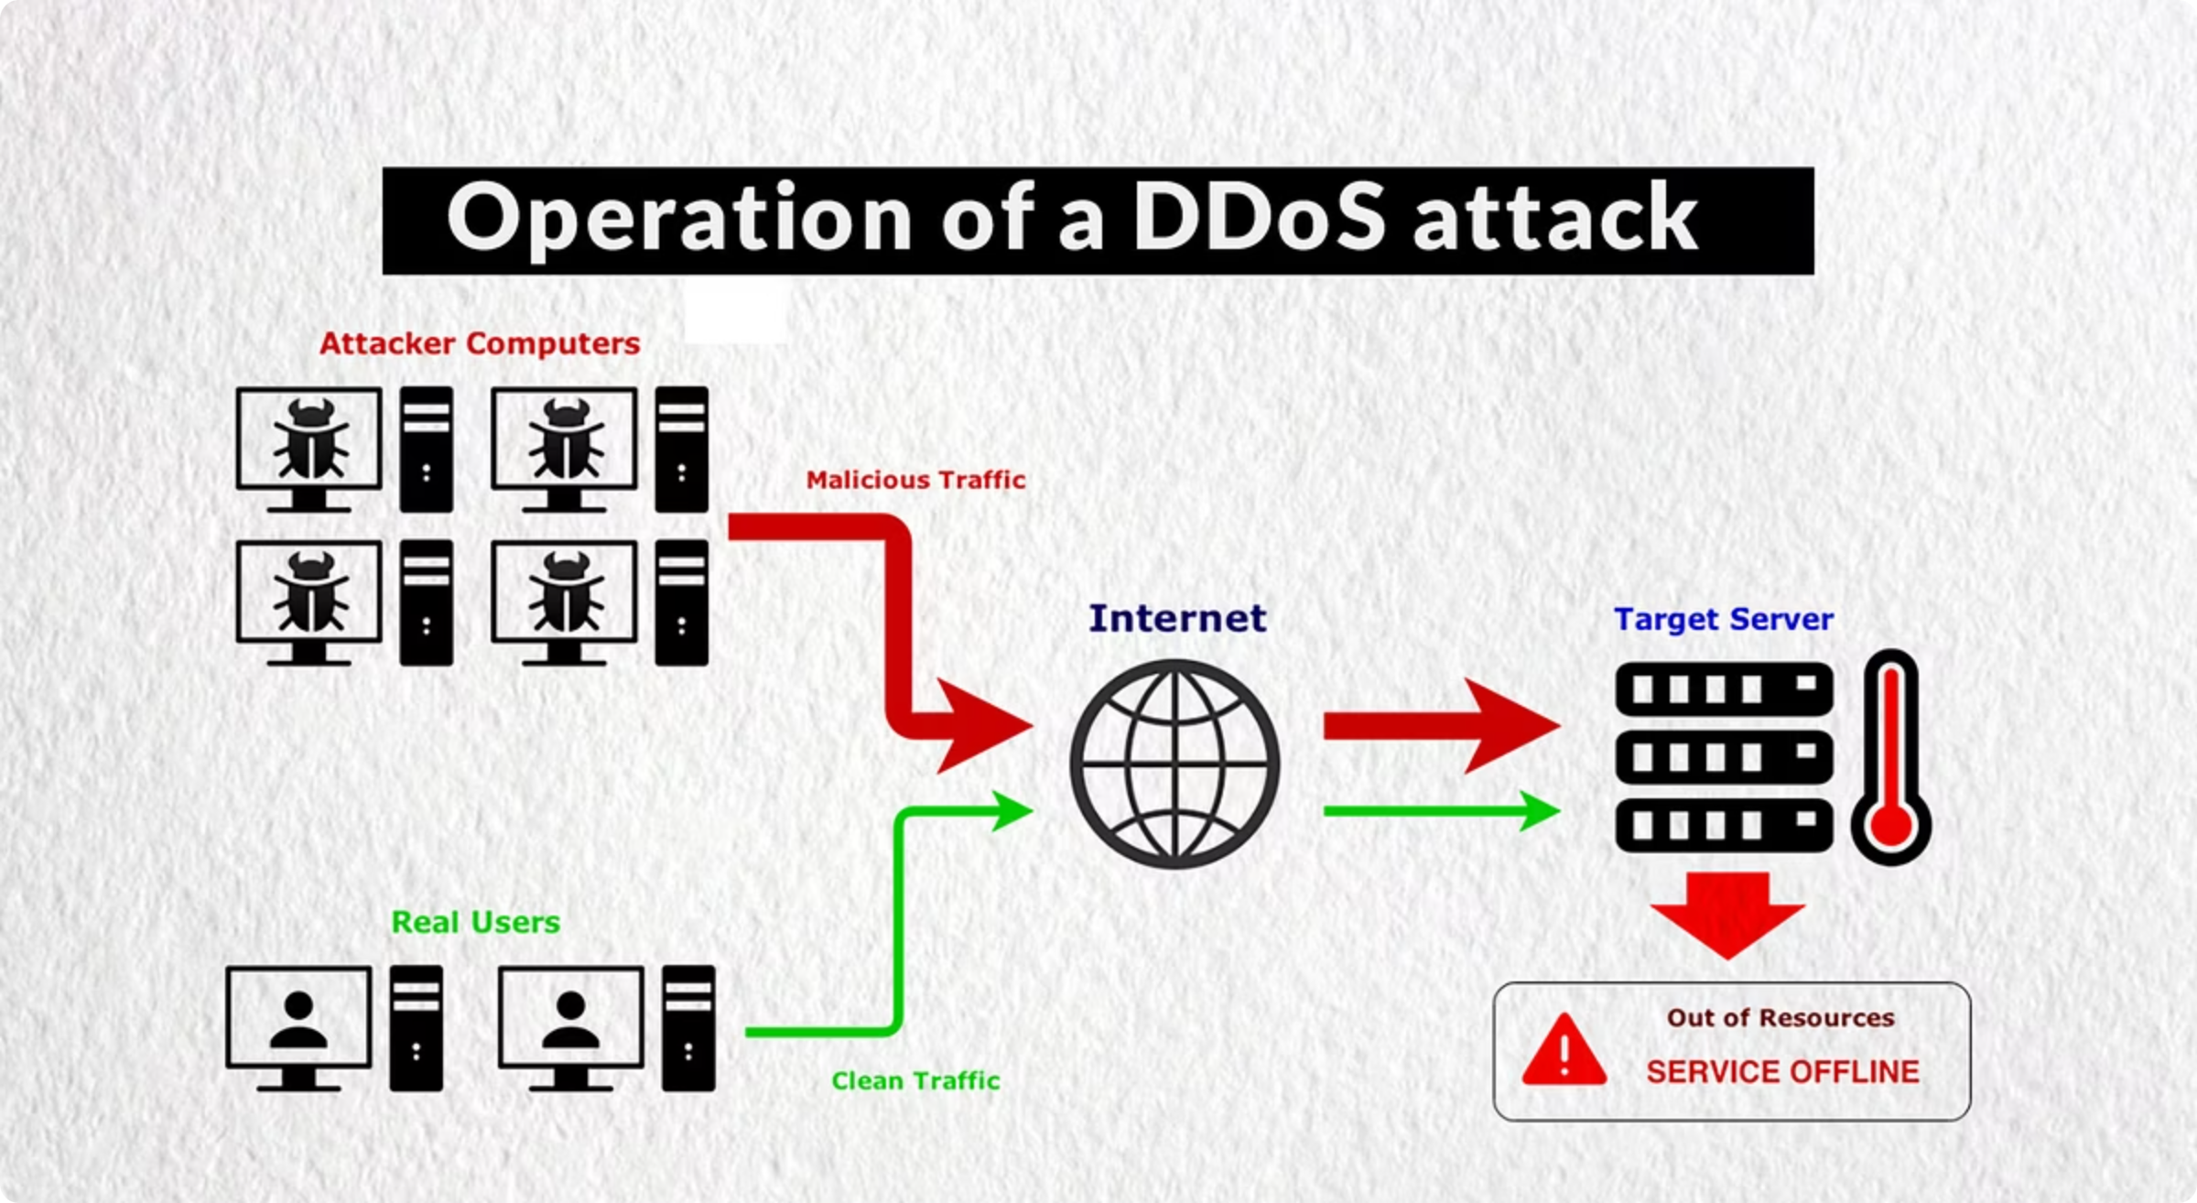
Why Use AWS Shield:
Mitigates common and large-scale DDoS attacks
24/7 DDoS response team (DRT) with Shield Advanced
No need for manual intervention

Slide 4

AWS Shield Standard Overview
Automatically included for all AWS users at no extra cost.
Protects against common network and transport layer attacks.
Mitigates over 99% of infrastructure layer attacks within one second.
Safeguards Amazon CloudFront, Route 53, and Global Accelerator.

Slide 5

AWS Shield Advanced Overview
Subscription-based enhanced protection service.
Detects and mitigates large, sophisticated DDoS attacks.
Provides near real-time attack visibility and cost protection.
Offers 24/7 access to the dedicated AWS Shield Response Team (SRT) for expert support.

Slide 6
Feature
AWS Shield Standard
AWS Shield Advanced
Cost
Free
Paid
Protection
Basic DDoS
Enhanced DDoS
Reporting
Basic
Detailed Metrics
DRT Support
No
Yes
SLA
No
Yes

Slide 7




Types of Attacks Mitigated by AWS Shield
Volumetric Attacks
Protocol Attacks
Saturate network capacity with high volumes of traffic, like UDP floods and ICMP floods.
Exploit vulnerabilities in network protocols, such as TCP SYN floods and fragmented packet attacks.
Application Layer Attacks
Zero-Day & Known Vectors
Target web applications with HTTP floods, DNS query floods, and other resource-exhausting requests.
Covers both new, unknown attack methods and established attack vectors with continuous threat intelligence updates.

Slide 8

Integration with AWS WAF for Application Layer Protection
AWS Shield Advanced seamlessly integrates with AWS WAF (Web Application Firewall) to provide comprehensive Layer 7 defence for your applications.
Automatic Rule Creation
Shield Advanced automatically creates WAF rules to block malicious requests during DDoS events.
Rate-Based Blocking
Enables intelligent rate-based blocking to mitigate excessive requests from suspicious IP addresses.
Custom WAF Rules
The Shield Response Team (SRT) can deploy custom WAF rules to counter specific, evolving attack patterns.

Slide 9
Benefits and Use Cases of AWS Shield
1
2
Reduced Downtime
Customised Protection
Automatic detection and mitigation capabilities minimise service interruptions.
Tailored to specific application traffic patterns and sensitivities.
3
4
Comprehensive Asset Coverage
Maintained Availability
Protects EC2, ELB, CloudFront, Global Accelerator, and Route 53.
Ensures low latency and continuous availability during attacks.

Slide 10
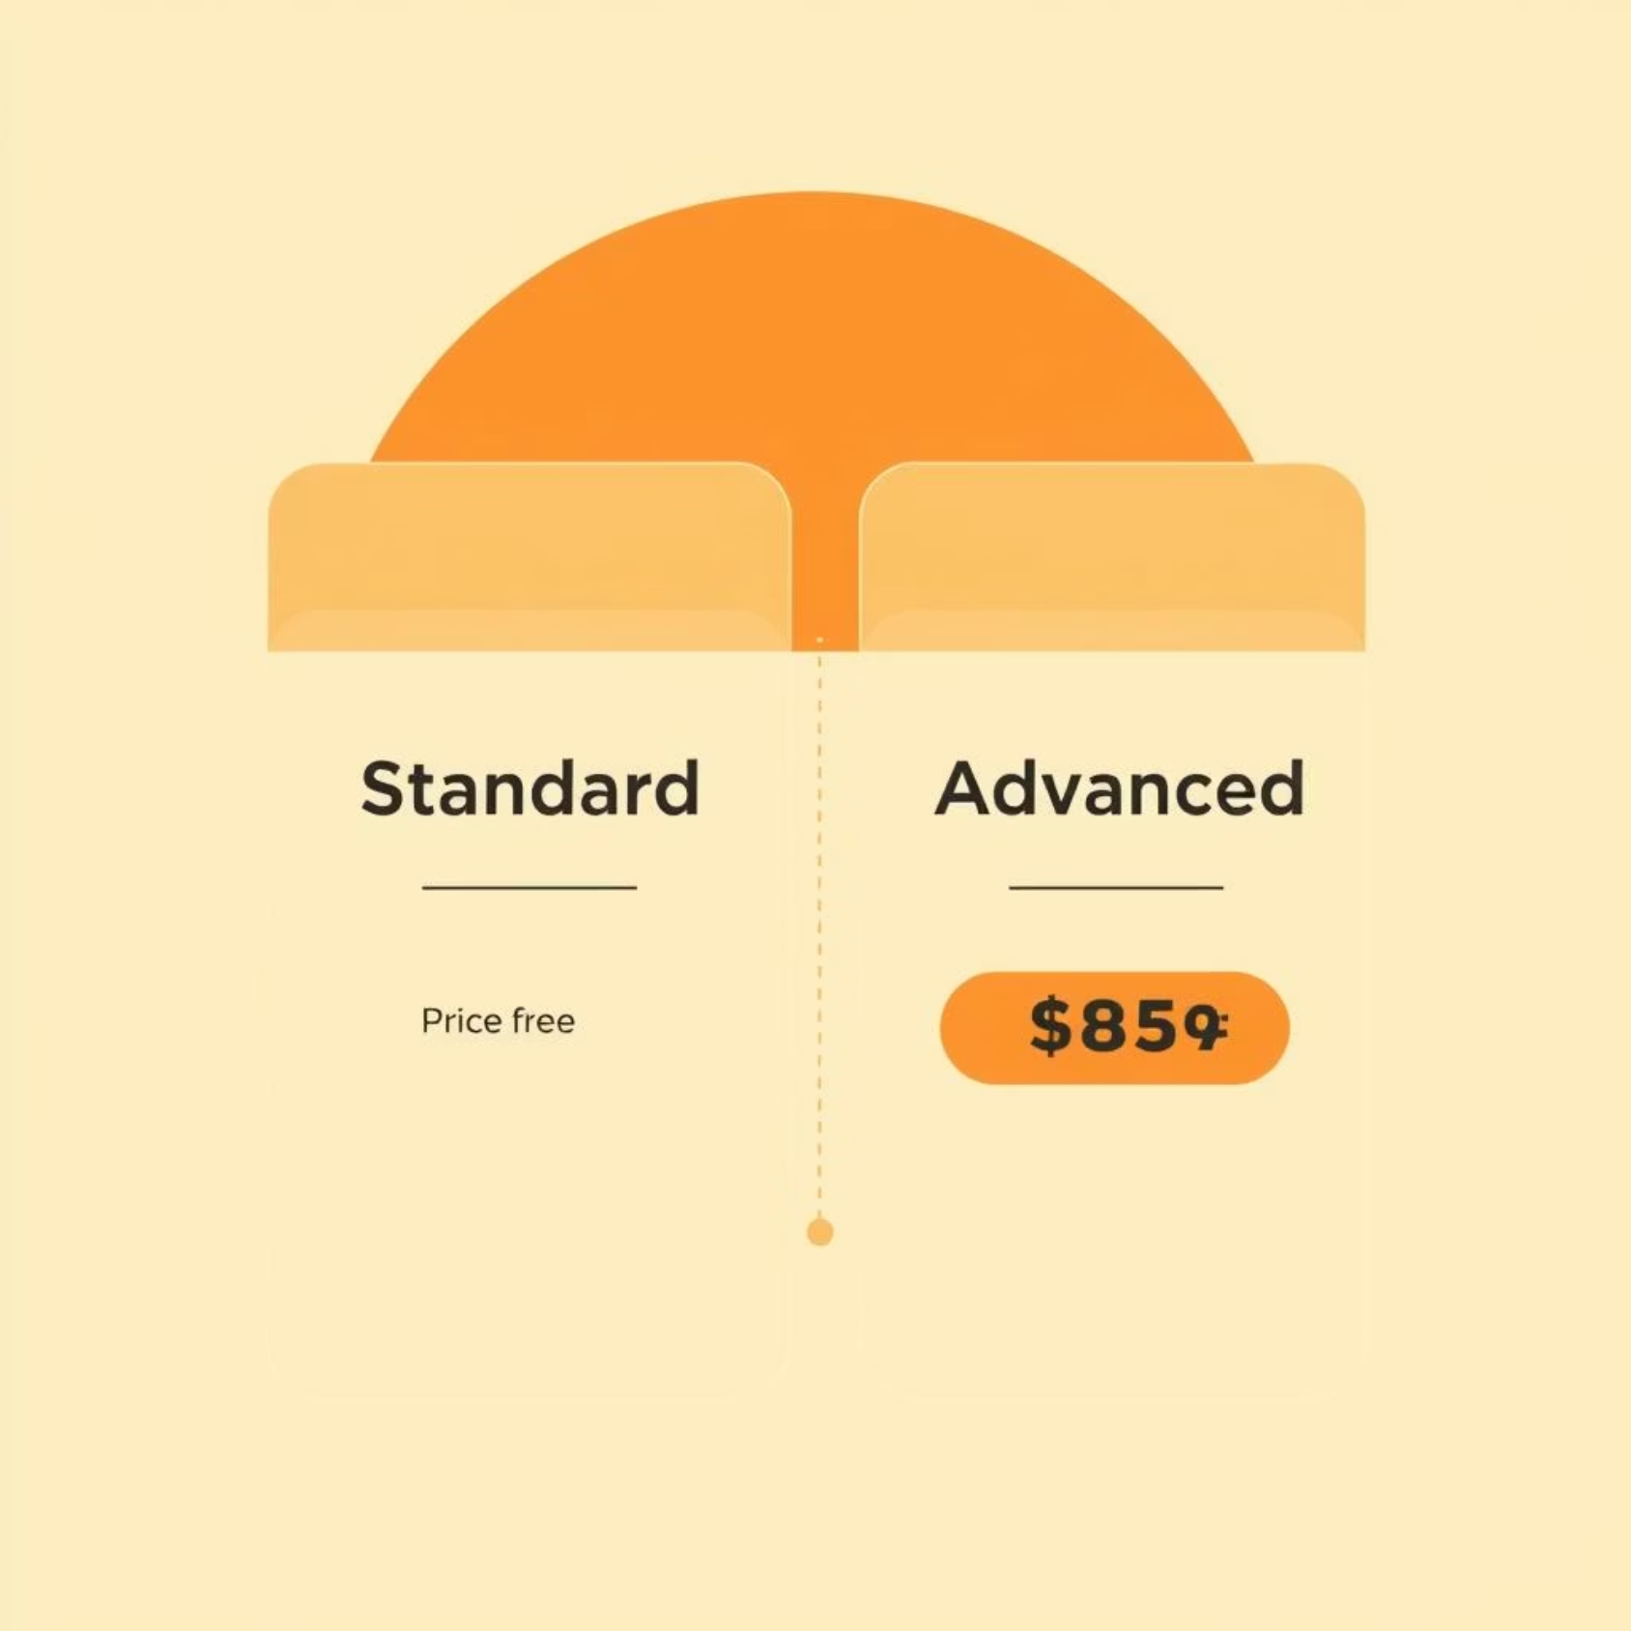
AWS Shield Pricing Overview
Shield Standard: Free
Included with all AWS services, providing baseline DDoS protection without additional charges.
Shield Advanced: Subscription + WAF Costs
Incurs a subscription fee, which covers the cost of AWS WAF usage during DDoS events across multiple accounts.
Additional WAF Features
Certain advanced AWS WAF features not directly related to DDoS mitigation may incur separate charges.
Notes:
AWS Shield is AWS's managed DDoS protection service It comes in two tiers - Standard and Advanced Shield Standard is free and provides baseline DDoS protection for all AWS services Shield Advanced is a paid subscription service that covers the costs of using AWS WAF during DDoS events across multiple accounts The Shield Advanced subscription also includes some additional advanced WAF features, which may have separate charges

Slide 11




Best Practices for AWS Shield Deployment
DDoS Resilient Architecture
Design your AWS architecture to be inherently resilient against DDoS attacks, adhering to AWS best practices.
Shield Advanced for Critical Apps
Deploy Shield Advanced for mission-critical, high-availability applications that require sophisticated protection.
Health-Based Detection
Enable health-based detection with Amazon Route 53 health checks to automatically shift traffic away from unhealthy resources during an attack.
Layered Security with AWS WAF
Combine Shield with AWS WAF to create a robust, layered security posture that protects against both infrastructure and application layer attacks.

Slide 12

Conclusion: Strengthen Cloud Security with AWS Shield
AWS Shield provides essential DDoS protection, ensuring cloud infrastructure resilience and availability.
Standard: automatic baseline protection.
Advanced: enhanced mitigation & expert support.
Integrates with AWS WAF for full application security.

Slide 13
Thank you

